Slide 1

Breweries In USA
Breweries In the USA
Brief Description of our Project
Analysis

Slide 2
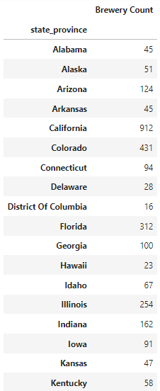
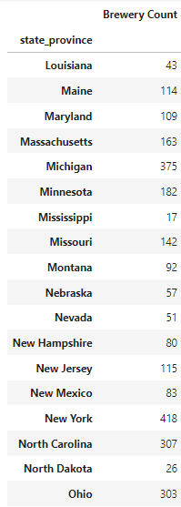
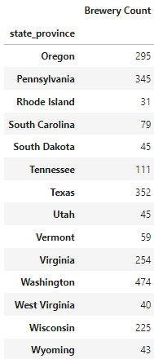
Number of Breweries per State
Brief Analysis

Slide 3
Consumption Rate to Number of Breweries
Brief Analysis

Slide 4
Average Income to Number of Breweries
Brief Analysis

Slide 5
Population 21 and Order of each State
Brief Analysis

Slide 6
State Population to Number of Breweries
Brief Analysis

